Slide 1
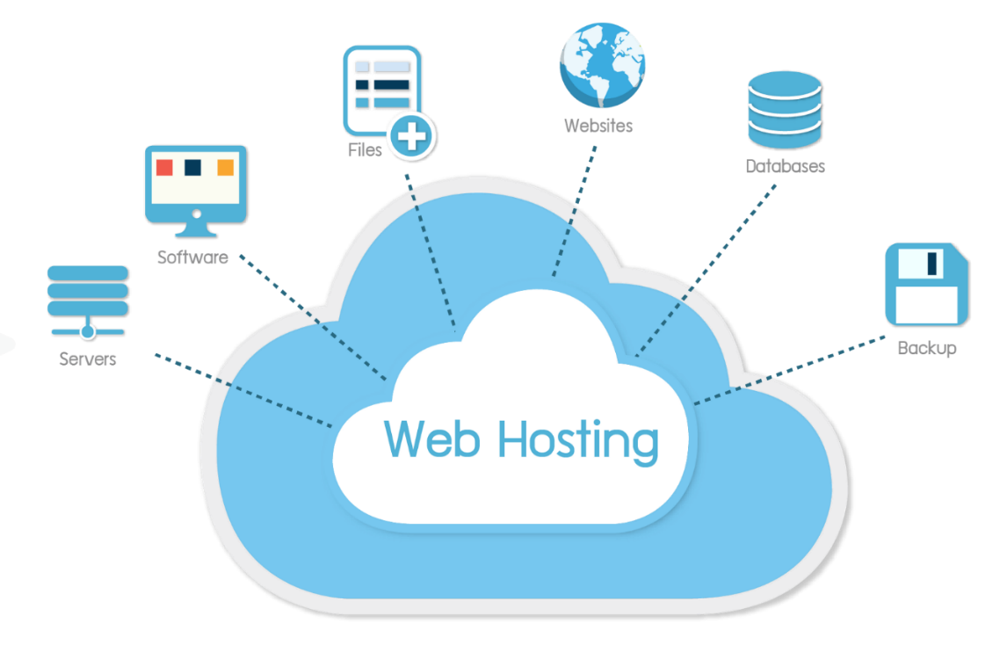
Web Hosting
Dr. Muhammad Habib

Slide 2

Web Hosting
By now, you know that websites and files are stored on web servers located in datacenters.
But what if you wanted to create your own website?
Do you really need your own datacenter with specialized hardware and software?

Slide 3
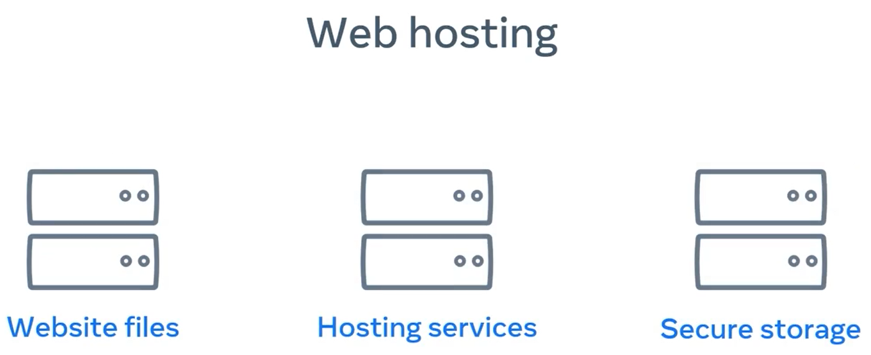
Web Hosting
Thankfully, the answer is no.
Developers can launch websites to the Internet using something known as web hosting.

Slide 4
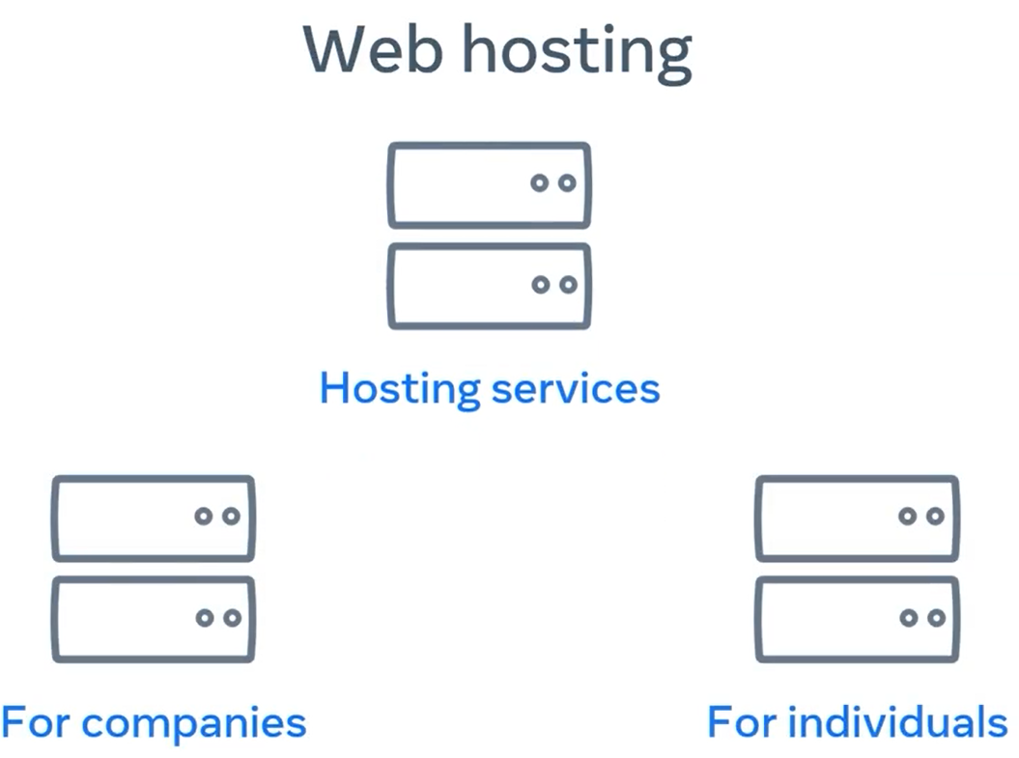
Web Hosting
Web hosting is a service where you place your website and files on the hosting companies web server.
You don't need to be accompanied to use a web host. Individuals can rent space too.

Slide 5
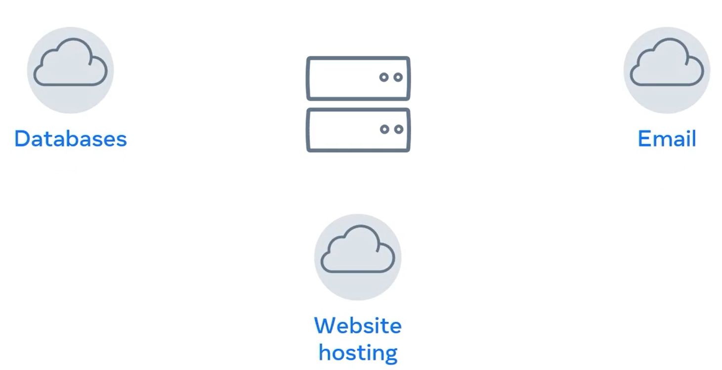
Web Hosting
You're essentially renting the space in return for stable and secure storage.

Slide 6
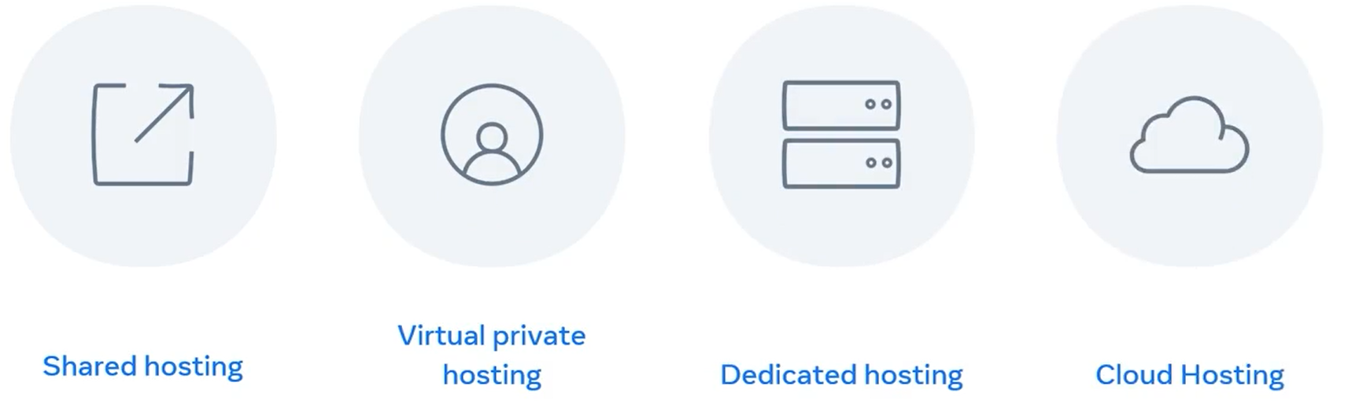
Web Hosting Options
The options include
shared hosting, virtual private hosting, dedicated hosting, and Cloud hosting.
Let's explore each of these hosting types in a little more detail now.

Slide 7
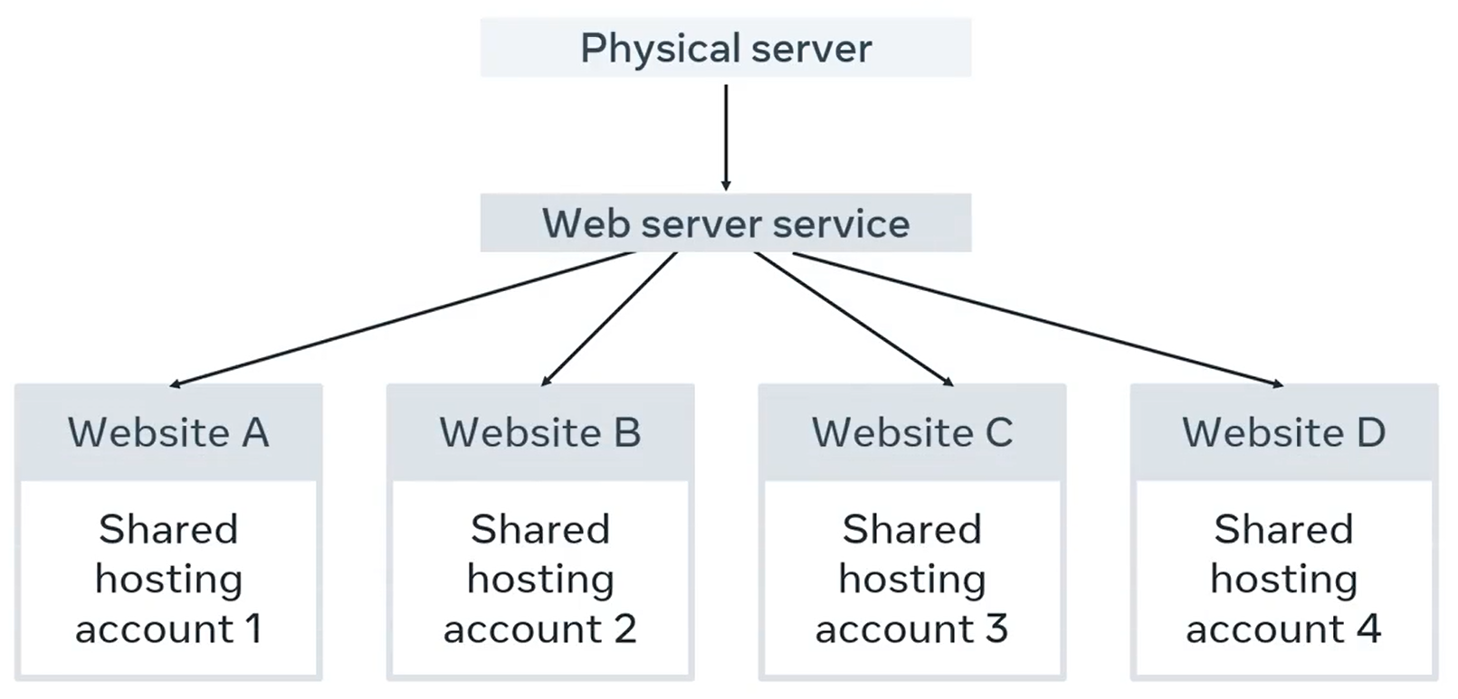
Shared Hosting

Slide 8
Shared Hosting
The cheapest form of web hosting is known as shared hosting.
You pay for a location on a web server containing many web hosting accounts with shared hosting.
This means that you also share the service processing power, memory, and bandwidth with other websites that might slow your performance.

Slide 9
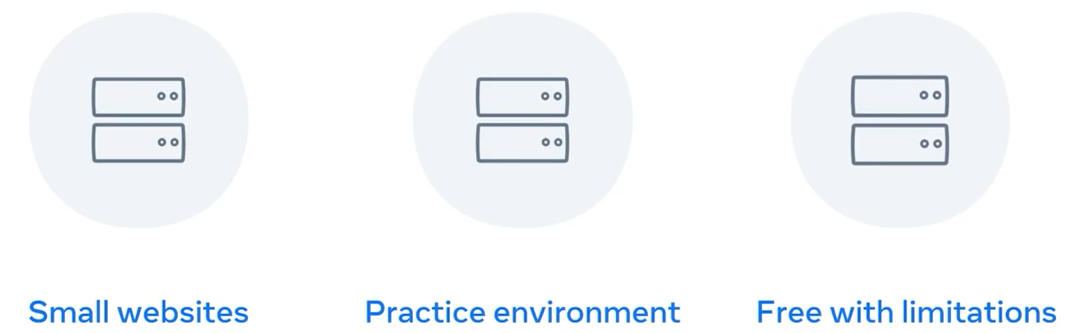
Shared Hosting
This option is best for a small website with a small number of visitors.
Many developers also use this as a low-cost sandbox environment to practice deploying or hosting their personal websites.
Some companies offer free shared hosting, but with limitations and often have advertisements embedded in the webpages.

Slide 10
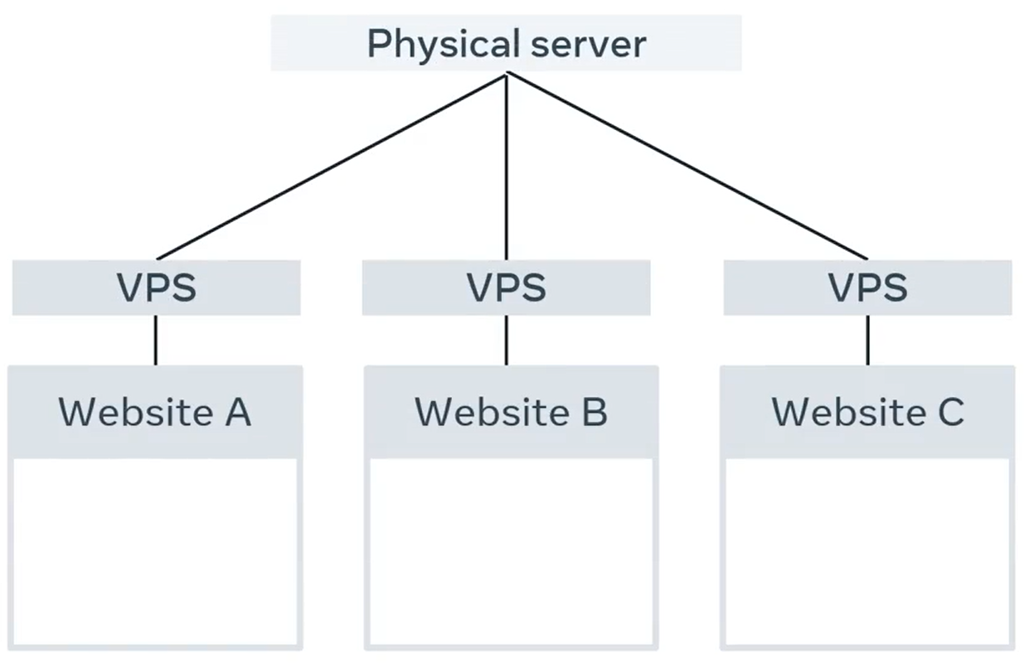
Virtual Private Service (VPS) Hosting

Slide 11
Virtual Private Service (VPS) Hosting
Sites with more considerable demands use virtual private surface or VPS.
A VPS is a virtual server with dedicated CPU, memory, and bandwidth resources.

Slide 12
Virtual Private Service (VPS) Hosting
It will be running on a hardware server with other VPS instances but as the resources are fixed per VPS instance, your website is unlikely to be impacted by the performance of other VPS instances.
A VPS instance will be more expensive than shared hosting.

Slide 13
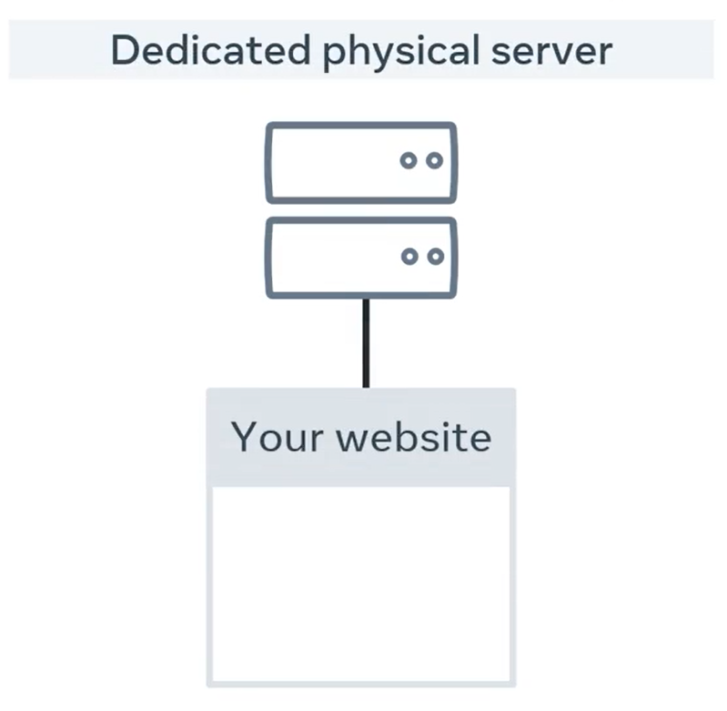
Dedicated Hosting

Slide 14
Dedicated Hosting
The next option up is to use dedicated hosting.
This will be a hardware server that is dedicated to you only.
All hardware, CPU, memory, and bandwidth resources are yours to use.
Generally, this option is more expensive than a VPS hosting.

Slide 15
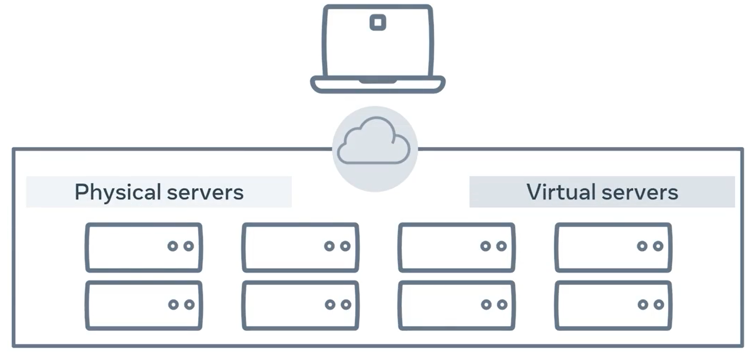
Cloud Hosting

Slide 16
Cloud Hosting
The last type of web hosting is something you may have heard of.
Cloud hosting and the Cloud has grown in popularity over the last decade and is often mentioned in various news and services you use.
With Cloud hosting, your website is run in something called a Cloud environment, which spans across multiple physical and virtual servers.

Slide 17
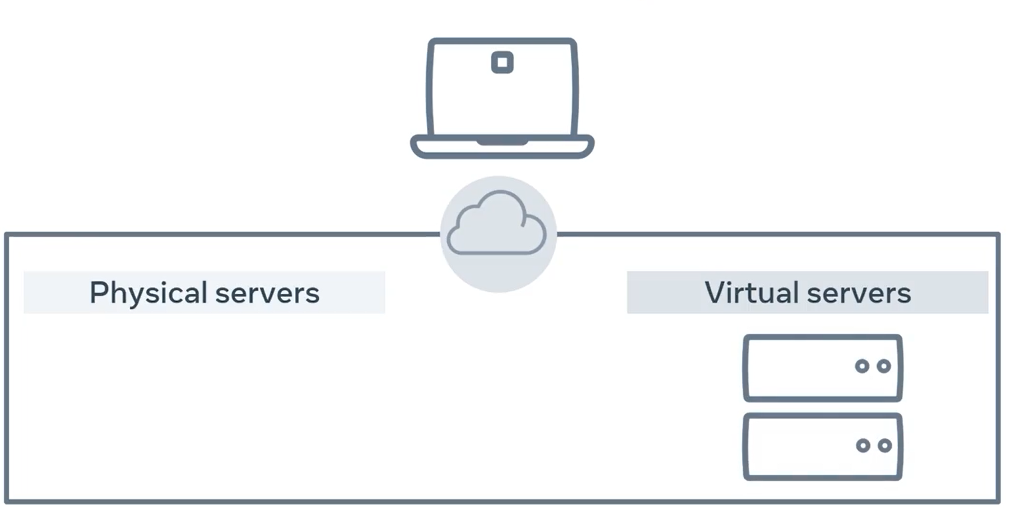
Cloud Hosting
If a physical or virtual server fails, your website will run on a different server and stay online.

Slide 18
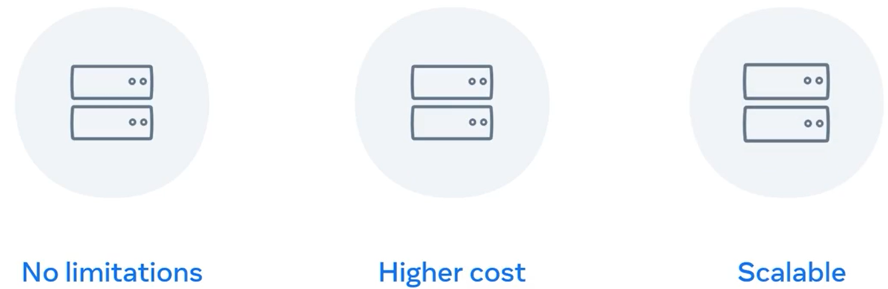
Cloud Hosting
The main advantage of Cloud hosting is that you can use as many resources as you need without hardware limitations.
However, you pay based on resource use.

Slide 19
Cloud Hosting
For example, if you transfer a file from the Cloud to a web browser, you'll pay for the bandwidth used for that transfer at a fractional cent cost per megabyte.
While this can quickly become more expensive, is allows websites and web applications to scale their costs as popularity grows.
This is how many of the major web applications operate.

Slide 20
Summary
In this lecture, you have learned about web hosting and the different hosting options available to individuals and companies.
Soon you will build your very first website.
Are you excited to get it hosted so you can share it with the world?
For more information on web hosting and Services do study new updates regularly.

Slide 21
Additional Resources
Learn more Here is a list of resources that may be helpful as you continue your learning journey.
What is a Web Server? (NGINX)
https://www.nginx.com/resources/glossary/web-server/
What is a Web Browser? (Mozilla)
https://www.mozilla.org/en-US/firefox/browsers/what-is-a-browser/
Who invented the Internet? And why? (Kurzgesagt)
https://youtu.be/21eFwbb48sE
What is Cloud Computing? (Amazon)
https://youtu.be/mxT233EdY5c
Browser Engines (Wikipedia)
https://en.wikipedia.org/wiki/Browser_engine

Slide 22
Thank You

